Slide 1
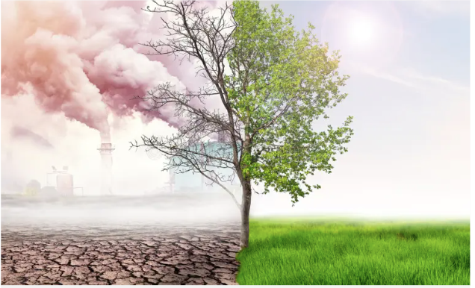

Vanishing Green:India’s Battle With Pollution
A Data-Driven Analysis of Tree Destruction & Environmental Impact (2010–2023)

Slide 2
Project Objective
This project aims to analyze environmental damage in India from 2010–2023, focusing on tree destruction, pollution incidents, affected regions, causes, and government responses. The goal is to uncover insights that inform policy and action.

Slide 3
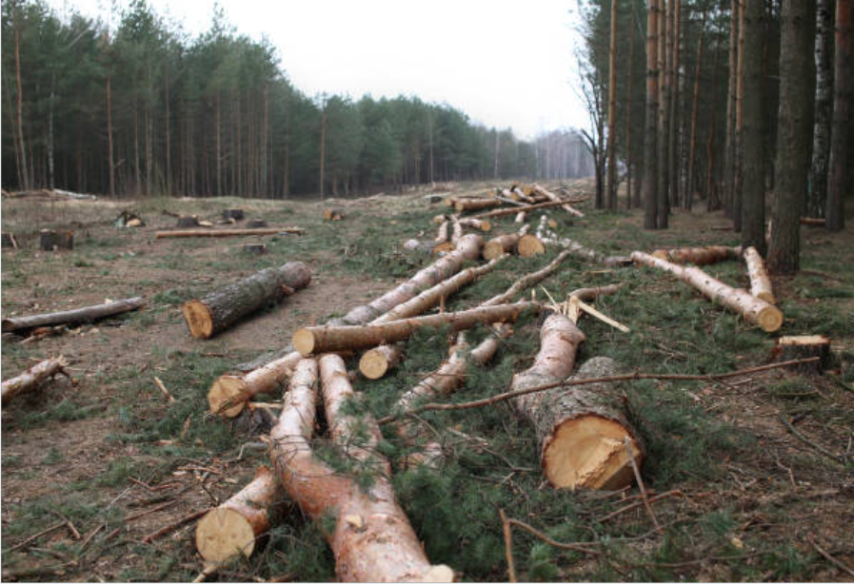
Data And Methodology
  This project utilises data from a Kaggle dataset spanning 2010 to 2023 to examine the scope and causes of environmental degradation in India.
  The data underwent a cleaning process and was visualized using Tableau.
    The visualisations featured maps, key performance indicators (KPIs), heat maps, bar charts, and pie charts.
Additionally, calculated fields were developed for % of total incidents,% of trees destroyed, average response time.

Slide 4
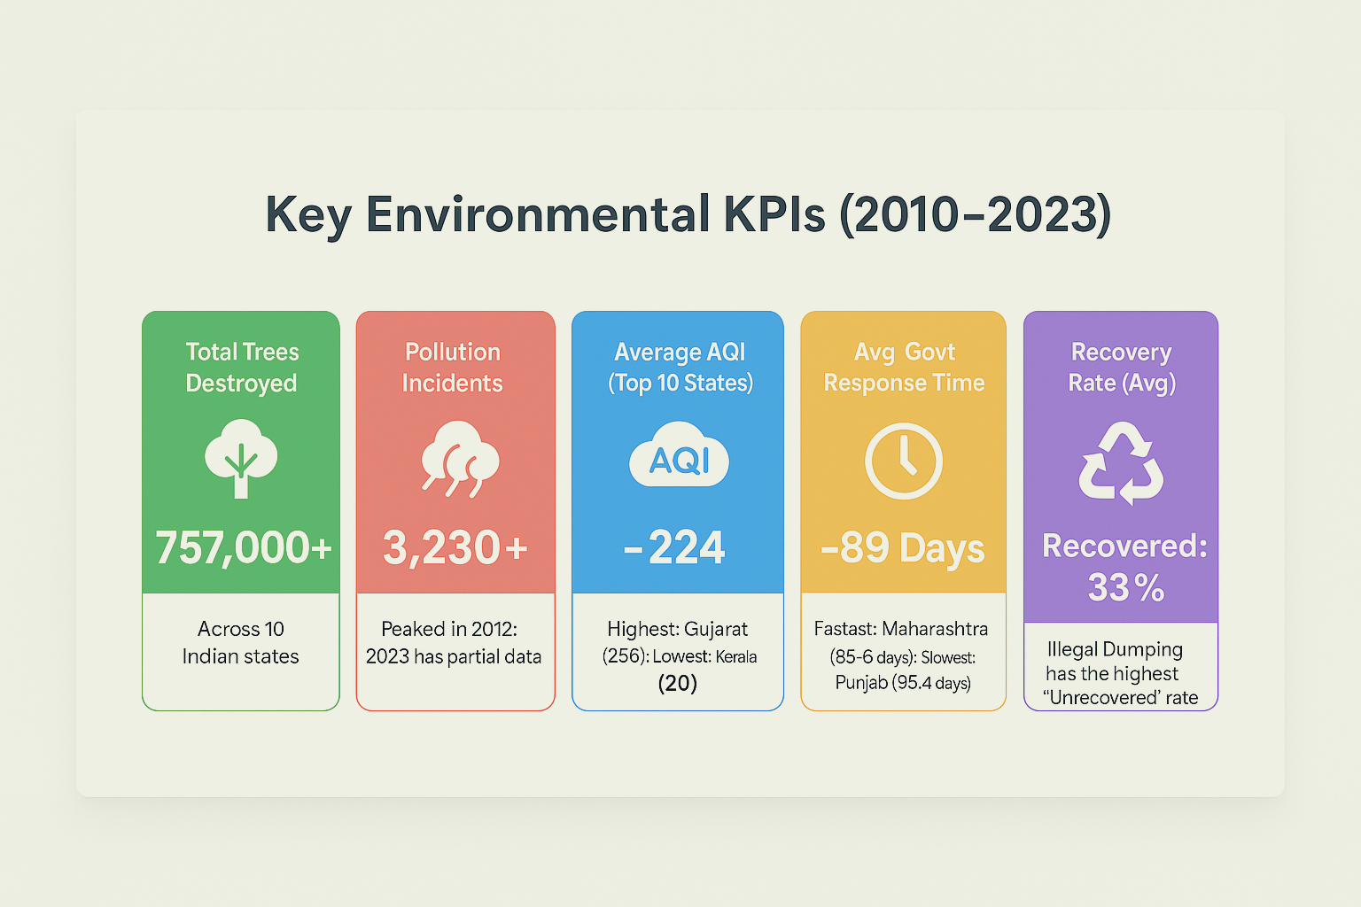
Key Performance Indicators

Slide 5
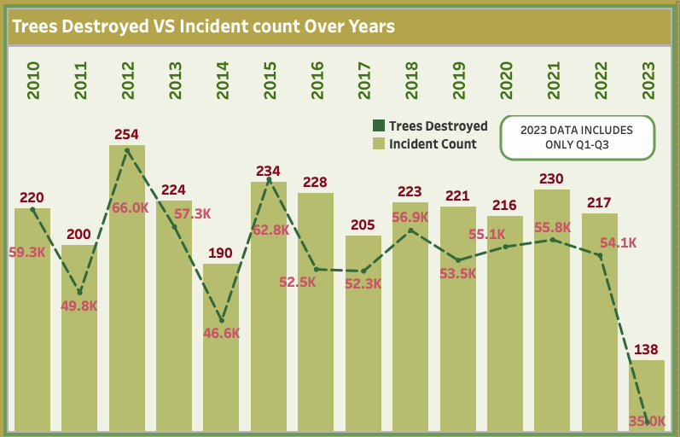
Trends in Trees Destroyed and Incident Count (2010–2023)
  Observed Correlation:
    Years with a higher number of pollution incidents generally experience greater tree loss (e.g., 2012, 2015).
  Incomplete Drop in 2023:
    The year 2023 shows a decline in both metrics; however, this is primarily due to data being available for only three quarters
  Complex Causation:
    Pollution can harm trees through air, water, and soil contamination.
    The destruction of trees can worsen pollution, leading to a decrease in natural air filtration.
  Likely Feedback Loop:
    These two factors may reinforce each other, resulting in a cycle of environmental degradation.

Slide 6
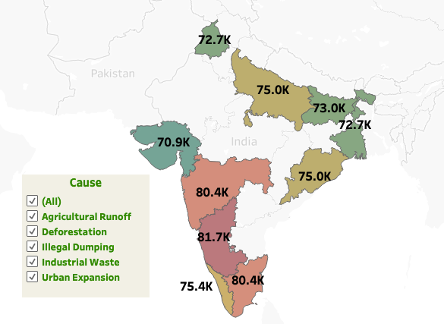
Geographic & Cause Analysis
Top 3 Causes of Tree Destruction:
1.Agricultural Runoff – 153,785 trees
2.Industrial Waste – 153,813 trees
3.Illegal Dumping – 153,187 trees
  Deforestation and urban expansion are closely following these causes, indicating that various human activities contribute almost equally to tree loss.
State Hotspots:
  Maharashtra, Tamil Nadu, Karnataka, and Kerala consistently report high destruction figures across all causes.
  Kerala particularly experiences significant losses due to illegal dumping (20,780 trees) and agricultural runoff (13,684 trees).
  West Bengal and Odisha show comparatively lower figures but are still present in all categories.
Multifactor Pressure:
  The data indicates that tree loss is not solely caused by one major factor; rather, it results from a combination of multiple environmental threats across different states.

Slide 7
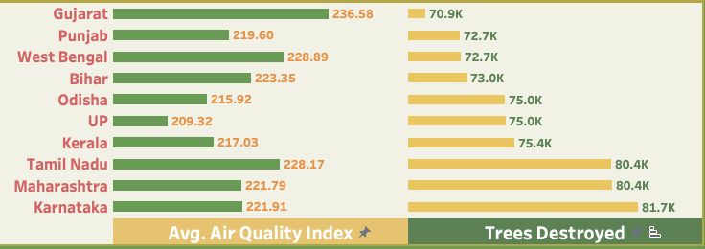
Exploring Connection Between Tree Loss and AQI Of States
  Gujarat has the highest AQI (236.6) but not the highest tree loss pointing to non-forest related pollution like industrial emissions or urban traffic.
  Karnataka and Maharashtra show both high tree loss and moderately high AQI, suggesting a combined effect of deforestation and pollution.
  Uttar Pradesh shows moderate tree loss but best air quality (AQI 209) possibly due to better vegetation cover in key areas or lower industrial density.
  There is no perfect one-to-one correlation, reinforcing the idea that air pollution is multi-causal, though tree destruction does amplify its impact.

Slide 8
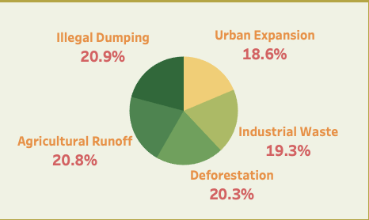
Wildlife Loss Across Pollution Causes
  Illegal Dumping is the most detrimental to wildlife, impacting over 93k+ animals, likely due to toxic exposure and habitat contamination.
  Agricultural Runoff follows closely, leading to losses of more than 92.8k+ wildlife, primarily from pesticides and fertilizers infiltrating ecosystems.
  Urban Expansion and Industrial Waste together account for over 38% of the total wildlife impact, highlighting the cumulative effects of unplanned development.
  Each of the five causes independently results in over 80K+ wildlife losses, emphasizing that no single factor can be overlooked in policy interventions.

Slide 9
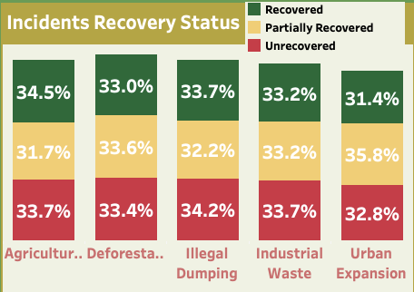
Which Environmental Damages Are Hardest To Recover From?
  Urban Expansion exhibits the lowest full recovery rate at 31.4%, coupled with the highest partial recovery rate of 35.8%, indicating that restoration tends to be slow or limited once urbanization occurs.
  Illegal Dumping presents the highest percentage of unrecovered cases at 34.16%, suggesting that full cleanup and restoration may prove challenging.
  Industrial Waste and Deforestation demonstrate a nearly equal distribution across various recovery statuses, each around 33%, reflecting moderate recovery success while still facing ongoing challenges.
  Agricultural Runoff boasts the highest recovery rate at 34.5%, indicating that it may be more manageable with enhanced practices and policies.

Slide 10
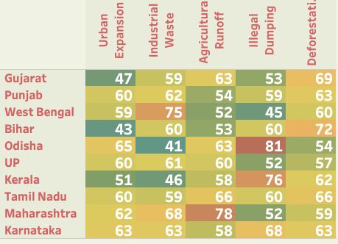
State-wise Environmental Pressures by Pollution Type
Bihar
    Faces the highest impact from deforestation with 72 incidents.
    Notable challenges in all other causes (ranging from 50 to 60), indicating diverse environmental issues.
Gujarat
    High levels of agricultural runoff (63) and deforestation (69).
    Slightly lower in urban expansion (47), but continues to show consistent environmental stress.
Karnataka
    Uniformly high incidents across all causes (each above 60).
    Indicates broad-spectrum pollution threats, from runoff to urbanization.
Kerala
    Leads in illegal dumping with a significant 76 incidents a major concern.
    Lower levels of deforestation and industrial waste (approximately 60 and 46) suggest challenges focused on waste management.
Maharashtra
    Highest in agricultural runoff (78) and significant industrial waste (68).
    Consistent across all causes, indicating high levels of industrial and agricultural pollution.

Slide 11
State-wise Environmental Pressures by Pollution Type
Odisha
    Tops the list for illegal dumping (81) and urban expansion (65).
    Relatively low in industrial waste (41), revealing unmanaged urban growth and waste as key threats.
Punjab
    Lacks extreme values, but all causes hover around 59 to 63.
    Reflects a consistent, medium-level environmental strain.
Tamil Nadu
    Displays balanced environmental pressure across all causes (approximately 60 each).
    No outlier incidents, but steady risks of degradation.
Uttar Pradesh
    Lower incidents in agricultural runoff and illegal dumping (52 each).
    Fairly consistent across other categories, likely due to mixed land use and the urban-rural divide.
West Bengal
    High levels of industrial waste (75) emerge as a standout issue.
    Relatively lower in other causes, likely driven by industrial pollution.

Slide 12
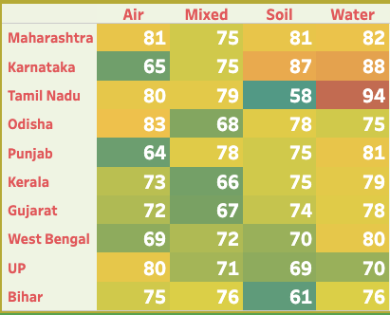
State-wise Pollution Incidents by Pollution Type
  Tamil Nadu has the highest water pollution (94) — needs urgent intervention in water quality.
  Maharashtra shows high levels across all pollution types (75–82) indicating overall environmental pressure.
  Odisha and Bihar show consistently high air and water pollution (75+), hinting at industrial and agricultural pollutants.
  Karnataka has highest soil pollution (87) and second-highest water pollution (88) possible links to waste mismanagement and runoff.
  Punjab has high mixed pollution (78) and water pollution (81) may be due to combined effects of agriculture and urban discharge.

Slide 13
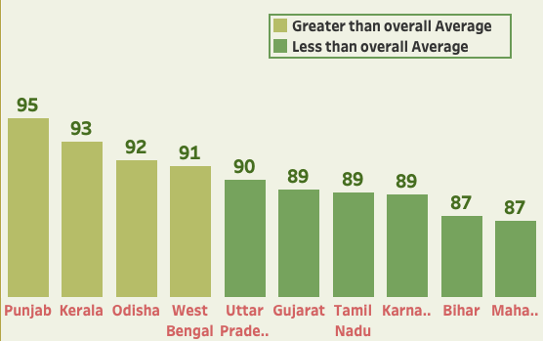
State-wise Pollution Incidents by Pollution Type
  Punjab (95.45 days) has the slowest average response, followed by Kerala (93.49) and Odisha (91.87) — may indicate bureaucratic delays or capacity issues.
  Maharashtra (86.61) and Bihar (87.02) have the fastest average response times, possibly due to better coordination or more frequent handling of cases.
  Most states fall in a narrow range (86–95 days), suggesting a systemic delay in environmental action.
Government response to pollution incidents takes nearly 3 months on average across states with Punjab and Kerala facing the most delay. Faster response mechanisms are critical for mitigation and recovery.

Slide 14
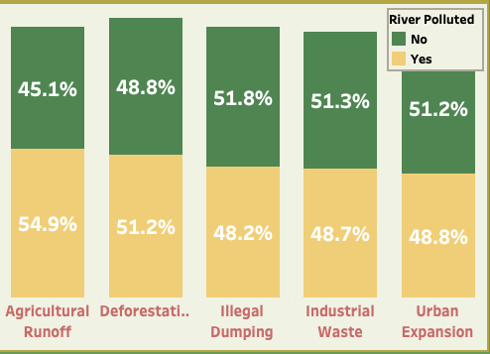
River Pollution Incidents by Pollution Cause
  Agricultural Runoff caused river pollution in ~55% of incidents (332 out of 605) the highest proportion among all causes.
  Deforestation led to river pollution in ~51% of cases surprising since it's usually linked to land, not water.
  Illegal Dumping and Industrial Waste show a rough balance, but still polluted rivers in ~48% of incidents each.
  Urban Expansion had river pollution in <49% of cases suggesting mixed impact on waterways.

Slide 15
Key Insights
Pollution Events and Deforestation: A Correlative Crisis
Pollution incidents and tree destruction appear to be correlated, and both may be contributing to a reinforcing cycle of environmental degradation.
The Complexity of Tree Destruction
Tree destruction is a multifaceted issue with no single culprit. Various factors including industrial activities, agricultural runoff, urban sprawl, and ineffective waste management are collectively stressing ecosystems.
The Need for Stronger Restoration Policies
Many environmental damages, particularly deforestation and urban expansion, remain unresolved, emphasizing the necessity for improved restoration policies and long-term planning.
State-Specific Environmental Challenges
Each state possesses a distinct environmental footprint. While some grapple with deforestation, others contend with urban expansion or illegal dumping. Customized, state-specific environmental policies are crucial for effective management.

Slide 16
Key Insights
Notable Cases: Tamil Nadu, Karnataka, and Beyond
Tamil Nadu and Karnataka are highlighted for severe water and soil pollution, respectively. Maharashtra encounters significant environmental pressures across multiple areas, while Odisha and Bihar face challenges with air and water quality.
Government Response Times
On average, government responses to pollution incidents take nearly three months across states, with Punjab and Kerala experiencing the longest delays. Swift response mechanisms are vital for effective mitigation and recovery.
Agricultural Runoff: A Leading Pollutant
Agricultural runoff is the primary cause of water pollution, affecting rivers in over half of the reported incidents. Surprisingly, both deforestation and illegal dumping also contribute significantly to river pollution, underscoring indirect risks to water ecosystems.

Slide 17
Recommendations
Policy and Enforcement
  Implement stricter regulations on agricultural runoff, illegal dumping, and industrial waste, which are major contributors to tree loss and water pollution.
  Launch targeted afforestation initiatives in states experiencing high levels of tree destruction and pollution, such as Maharashtra, Karnataka, and Tamil Nadu.
Technology and Monitoring
  Establish quicker response frameworks by utilising digital reporting and GIS monitoring, aiming to decrease the current average response time of 90 days.
  Employ drones and satellite imagery to identify illegal deforestation and dumping activities at an early stage.
  Enforce environmental impact assessments (EIA) for major infrastructure and land use projects.
AQI
  Focus air quality controls on non-forest emission sources like traffic, industry, and construction
  Introduce urban tree plantation drives specifically in high-AQI districts.
  Couple afforestation with industrial and vehicular emission controls.
  Invest in green urban infrastructure like green roofs, roadside plantations, and low-emission transport.

Slide 18
Recommendations
Water-Specific Interventions
  Create riparian buffer zones and provide incentives for organic farming in states at high risk to mitigate river pollution caused by agricultural practices.
Public Awareness and Incentives
  Conduct awareness campaigns in urban areas regarding the effects of urban expansion and local waste management on recovery efforts and river health.
  Offer tax incentives or subsidies to industries that make proactive investments in green recovery initiatives or low-emission technologies.

Slide 19
Conclusion
The Tableau dashboard integrates a variety of environmental metrics, including pollution incidents, tree loss, air and water quality, recovery status, and response efficiency.It highlights both macro trends and state-level disparities, enabling data-driven decision-making.

Slide 20
📊 Explore the Interactive Dashboard:
https://public.tableau.com/views/Vanishinggreen/Dashboard15?:language=en-US&:sid=&:redirect=auth&:display_count=n&:origin=viz_share_link

Slide 21
Thank you

